Slide 1

EchoKeys
Vishal Mishra
Web Technology 1
Date of Submission: 10-09-2025
🎵 Bringing Music to Everyone, Everywhere

Slide 2
Introduction
EchoKeys is a Virtual Musical Instrument Website.
Languages used: HTML, CSS, JavaScript, Bootstrap
Purpose: To make music accessible and fun for everyone.

Slide 3
Our Mission
• Make music available to anyone, anywhere
• Empower people who cannot afford instruments
• Create opportunities for visually impaired individuals to enjoy music
• Encourage creativity and learning through technology

Slide 4
Features
🎹 Virtual Instruments: Guitar, Piano, Drum, Flute
🌍 Play Anywhere: Access on any device, anytime
🎉 Concert Room: Experience party-like atmosphere
📈 Future Scope: More instruments, multiplayer live concert via WebSockets

Slide 5

Technology Stack
• Frontend: HTML, CSS, Bootstrap
• Logic: JavaScript
• Responsive Design: Works on desktop & mobile

Slide 6

Inspiration
• Music is loved by everyone 🎶
• Inspired by legends like Baluji Shrivastav who proved music has no barriers
• Desire to make music inclusive and affordable

Slide 7

Future Enhancements
🎤 Live Concert Room with real-time collaboration (WebSockets)
🎛️ User-customizable instruments
🎧 Sound recording & sharing
👥 Social features: Invite friends, jam together online

Slide 8
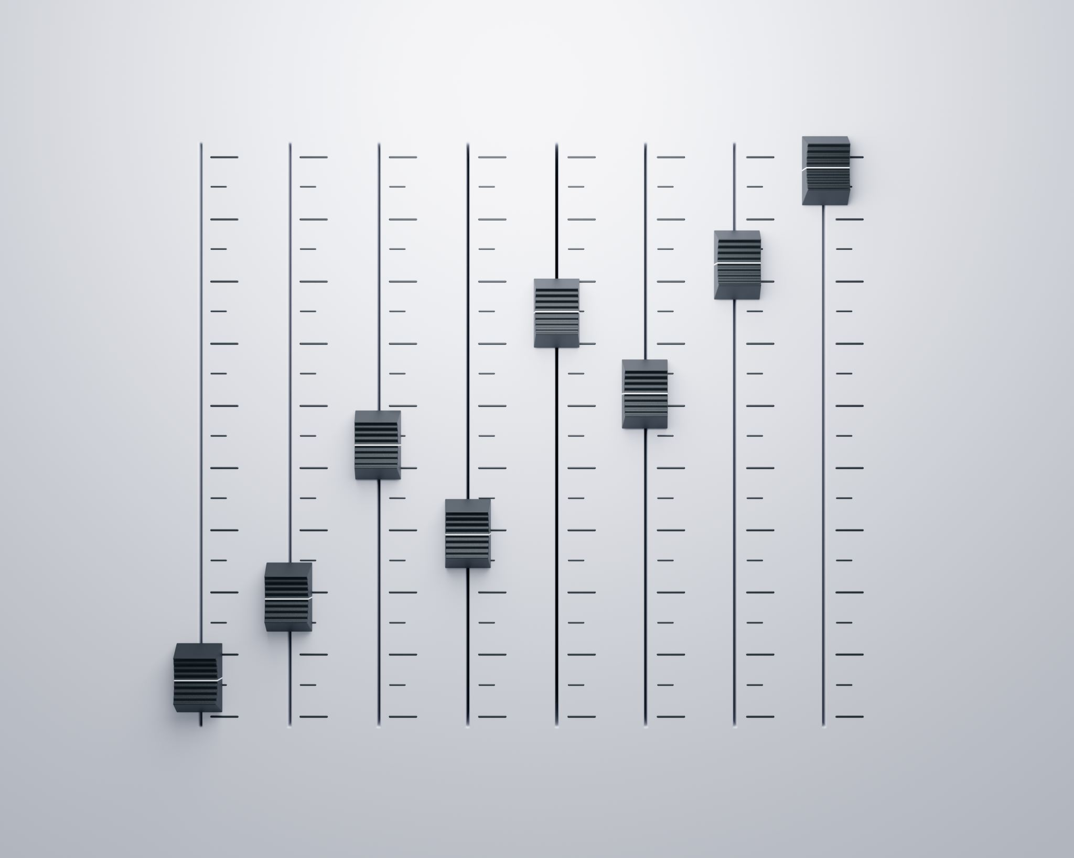
Demo
• Screenshots of EchoKeys website
• Highlight virtual instruments and concert room feature

Slide 9
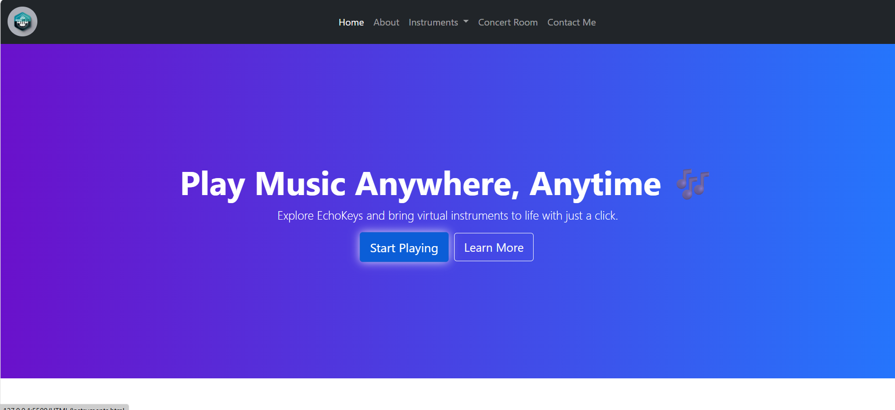

Slide 10
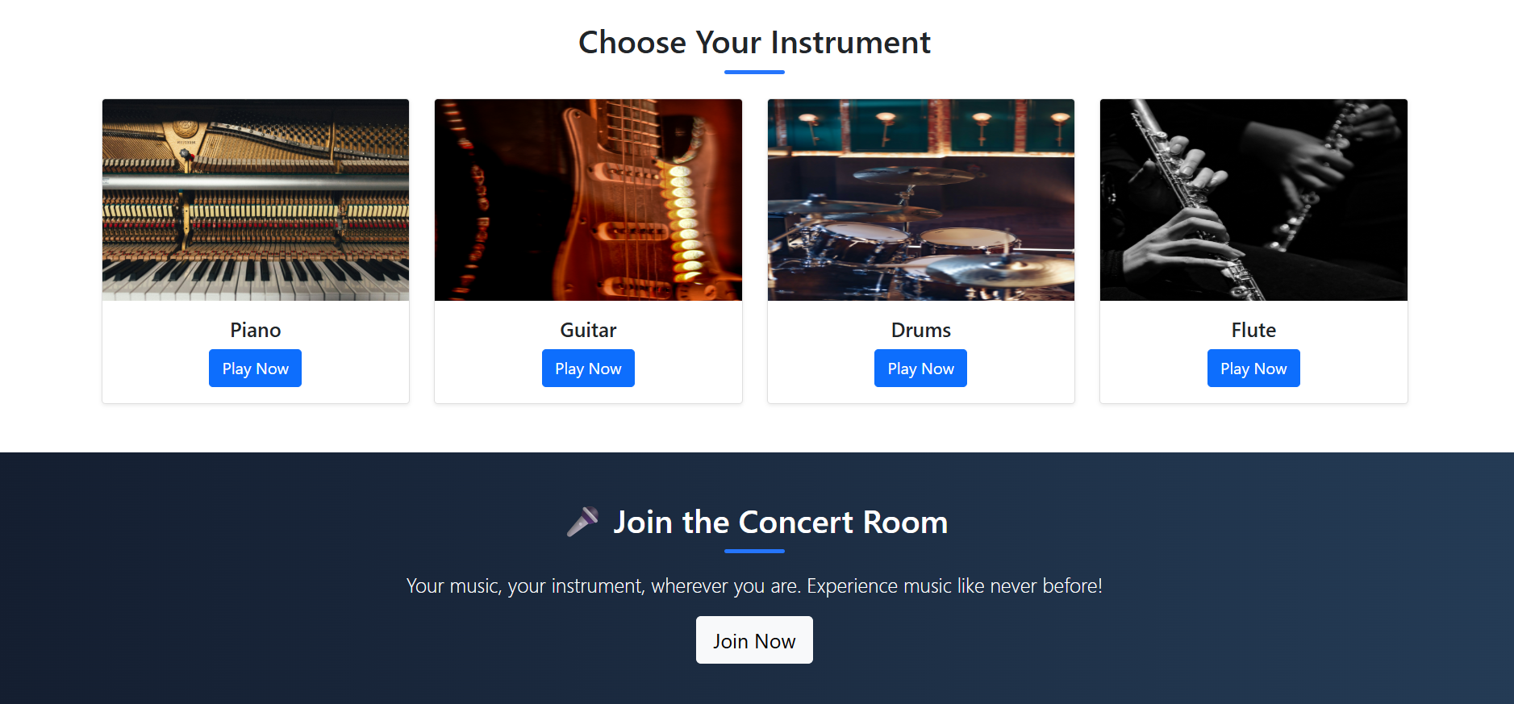

Slide 11
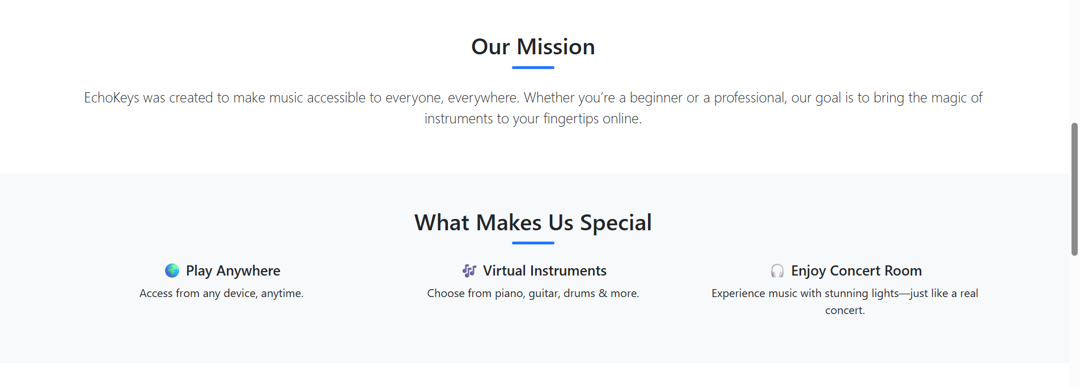

Slide 12
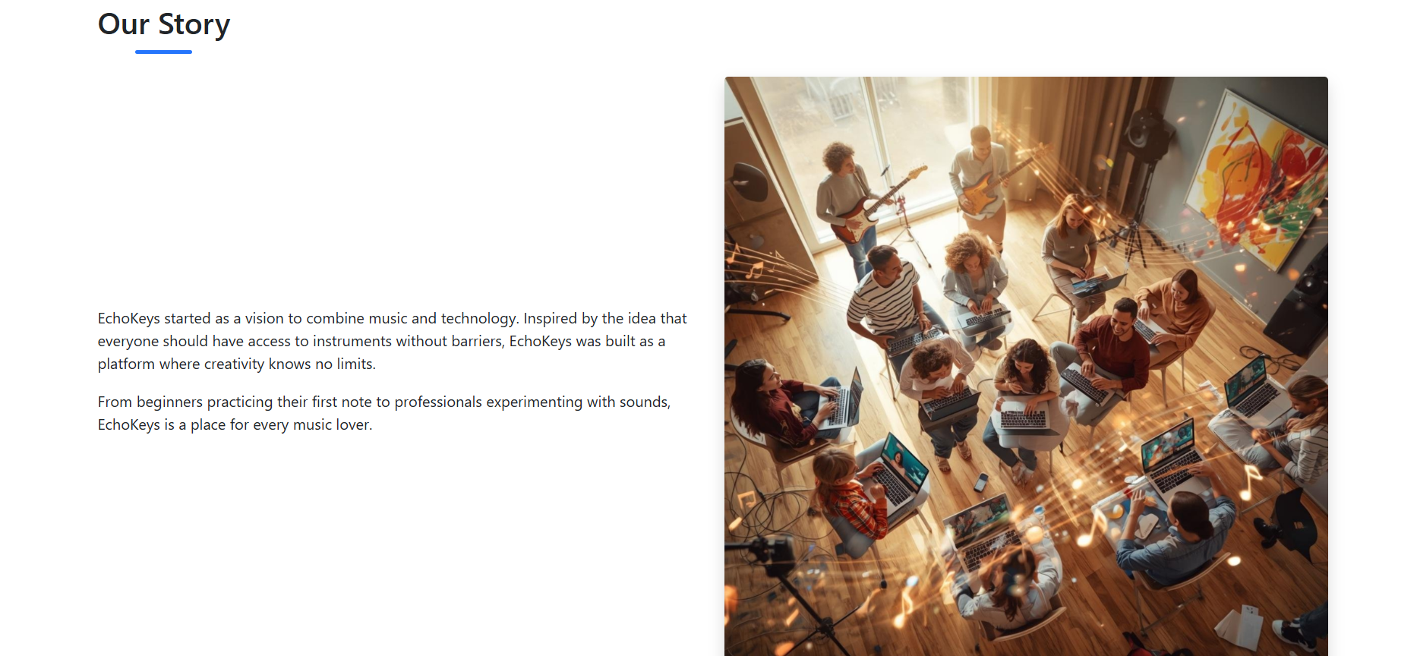

Slide 13
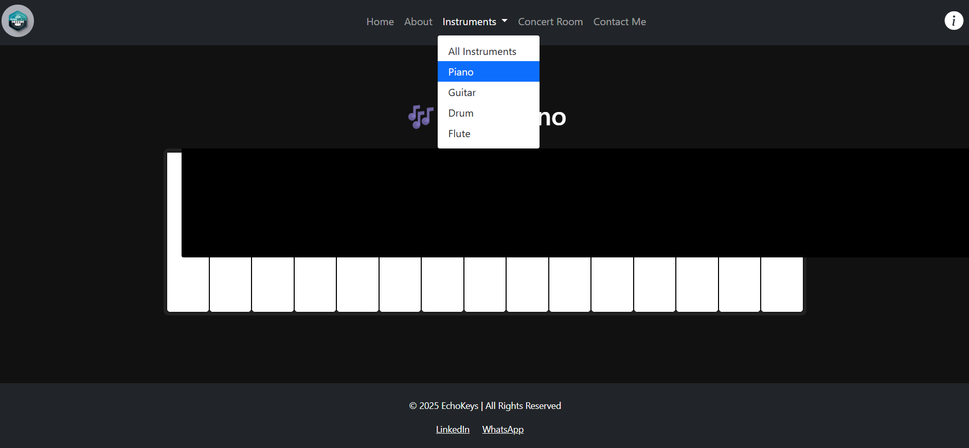

Slide 14
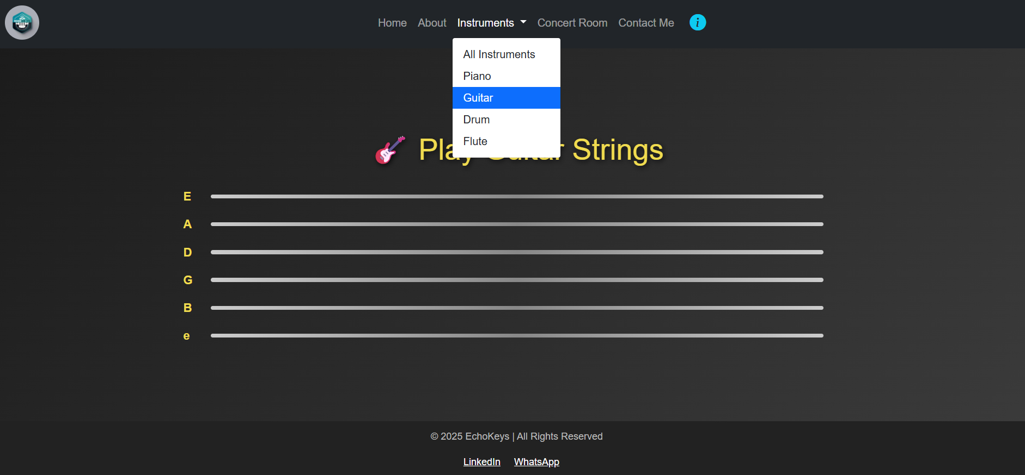

Slide 15
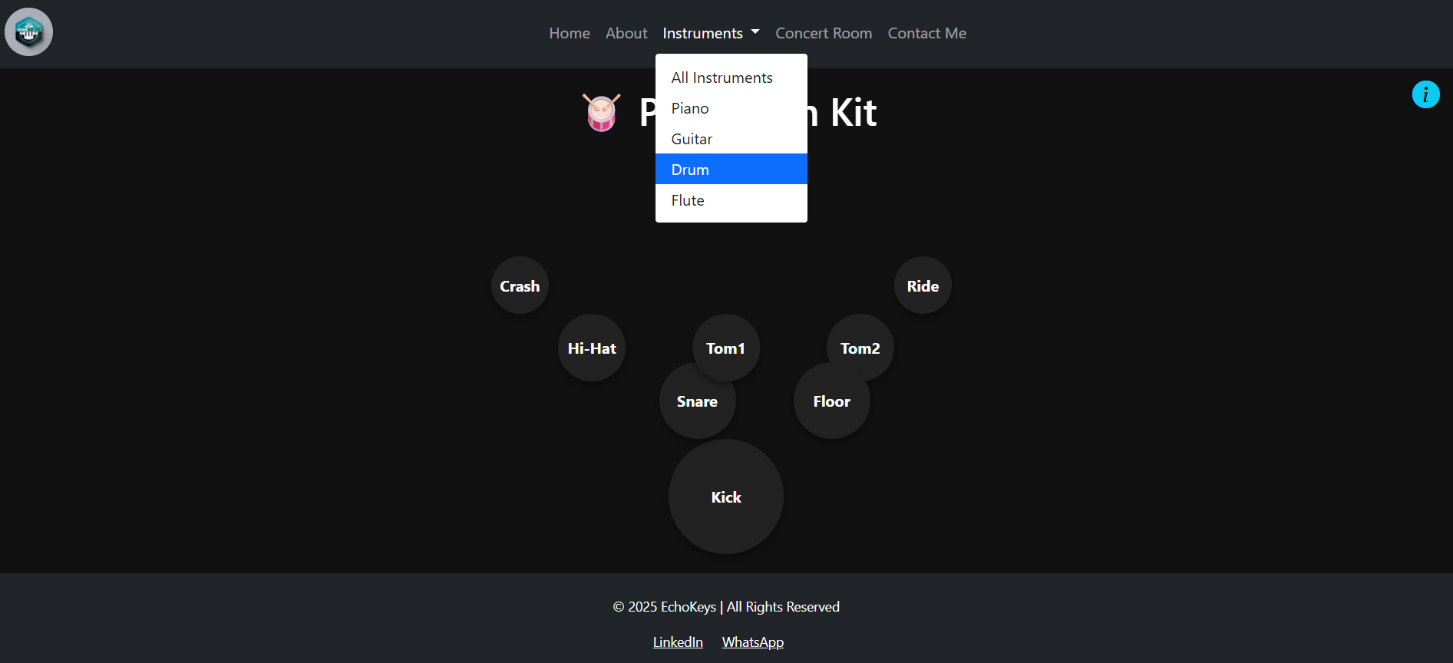

Slide 16
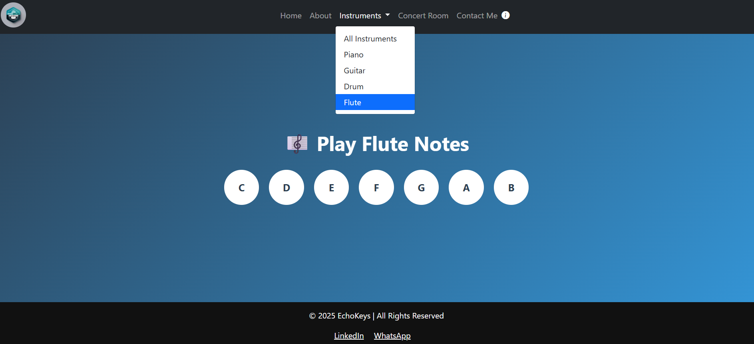

Slide 17
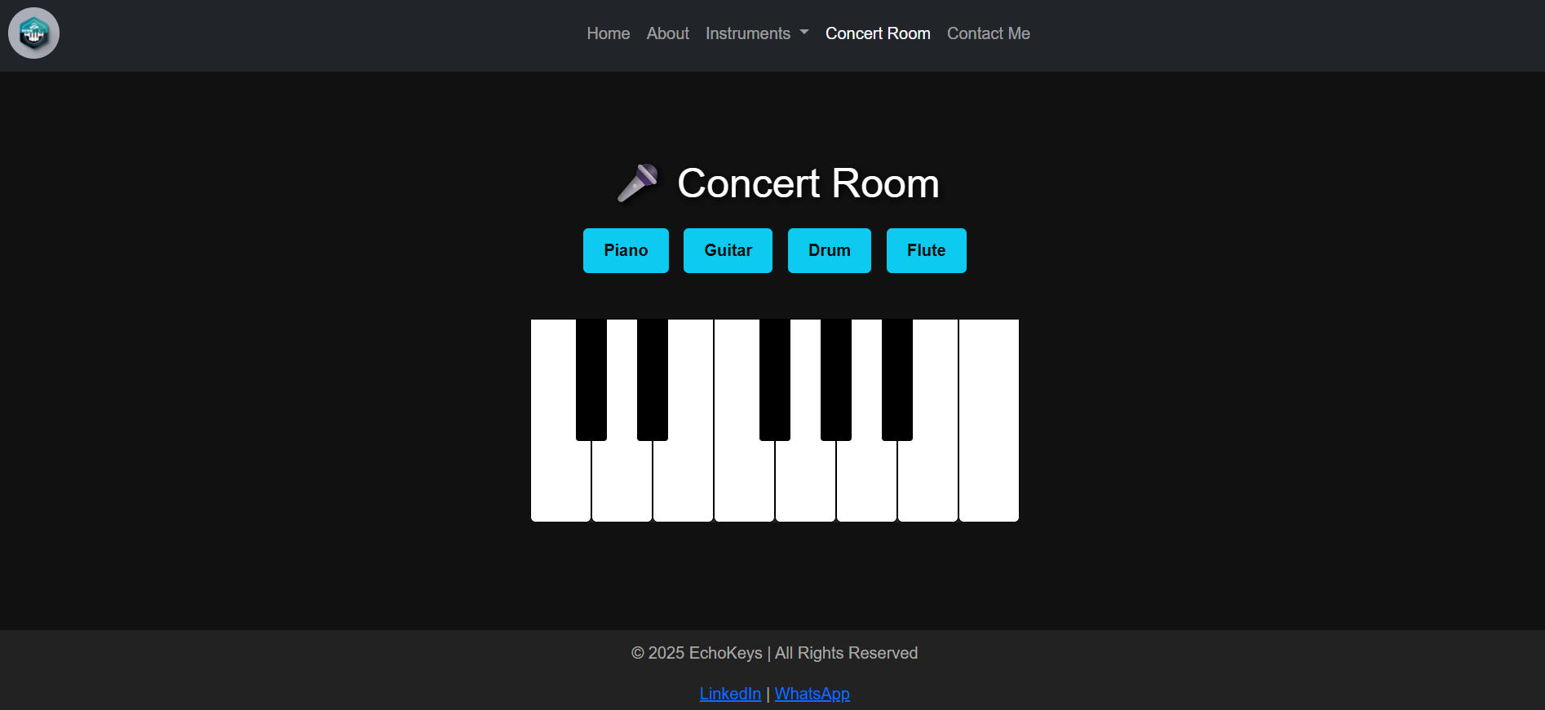

Slide 18
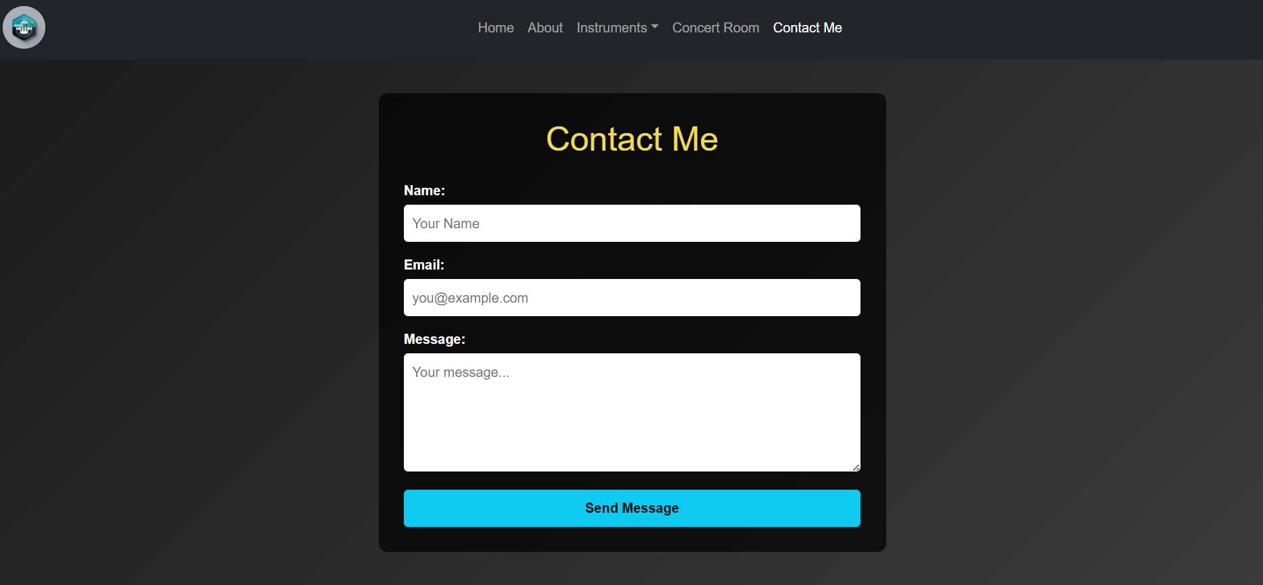

Slide 19

Conclusion
EchoKeys brings music to everyone’s fingertips.
Breaking barriers of cost, accessibility, and location.
🎵 The future of music is just one click away.

Slide 20

THANK YOU

